Slide 1
Data Science
UNIT-II
Hypothesis Testing

Slide 2
Hypothesis Testing:
Definition:
Hypothesis testing is the process of evaluating two competing hypotheses using sample data to decide whether the observed results are statistically significant.
Key Terminology
1. Null Hypothesis (H₀)
The null hypothesis states that there is no effect, no difference, or no relationship.
It is assumed to be true until evidence suggests otherwise.
Example:
H₀: The average blood glucose level of diabetic patients is 120 mg/dL.
2. Alternative Hypothesis (H₁ or Ha)
The alternative hypothesis represents the claim the researcher wants to prove.
It indicates an effect, difference, or relationship exists.
Example:
H₁: The average blood glucose level is not 120 mg/dL.

Slide 3
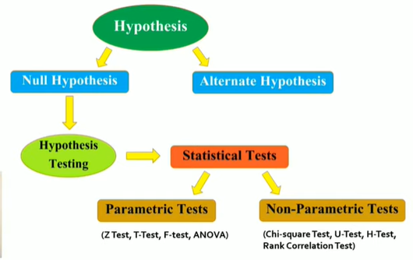
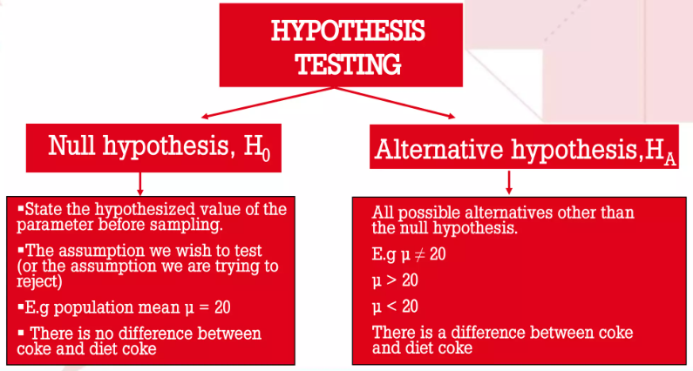

Slide 4
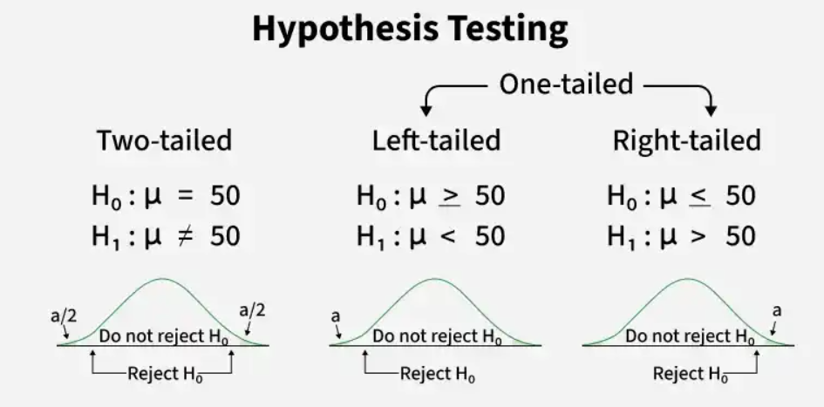
Types of Hypotheses
1. Two-Tailed Hypothesis
Tests whether the parameter is different from a specified value.
H₀: μ = 50
H₁: μ ≠ 50
Both tails of the distribution are considered.
2. Left-Tailed Hypothesis
Tests whether the parameter is less than a specified value.
H₀: μ ≥ 50
H₁: μ < 50
Only the left tail is considered.
3. Right-Tailed Hypothesis
Tests whether the parameter is greater than a specified value.
H₀: μ ≤ 50
H₁: μ > 50
Only the right tail is considered.

Slide 5
Steps in Hypothesis Testing
Step 1: State the Hypotheses
Formulate H₀ and H₁.
Step 2: Choose the Significance Level (α)
Common values:
    α = 0.05 (95% confidence)
    α = 0.01 (99% confidence)
    α = 0.10 (90% confidence)
Step 3: Select the Appropriate Statistical Test
Examples:
Data Type | Statistical Test
Mean (one sample) | One-sample t-test
Two independent means | Independent t-test
Paired observations | Paired t-test
More than two means | ANOVA
Variance | F-test
Categorical data | Chi-square test
Correlation | Pearson correlation test
Regression coefficients | t-test/F-test
Large sample mean | Z-test

Slide 6
Steps in Hypothesis Testing
Step 4: Calculate the Test Statistic
Step 5: Determine the Critical Value from statistical table or p-value
Compare: Test statistic with the critical value, or p-value with α.
If test statistic > critical value → reject H₀​.
If test statistic ≤ critical value → fail to reject H₀​.
Step 6: Make the Decision
    If p-value ≤ α, reject H₀.
    If p-value > α, insufficient evidence to reject H₀​, not proof that H₀​ is true.
Applications of Hypothesis Testing
Medical and clinical trials
Machine learning model evaluation
Business decision-making
Quality control in manufacturing
Marketing and A/B testing
Social science research
Financial and economic analysis
Engineering and industrial experiments

Slide 7
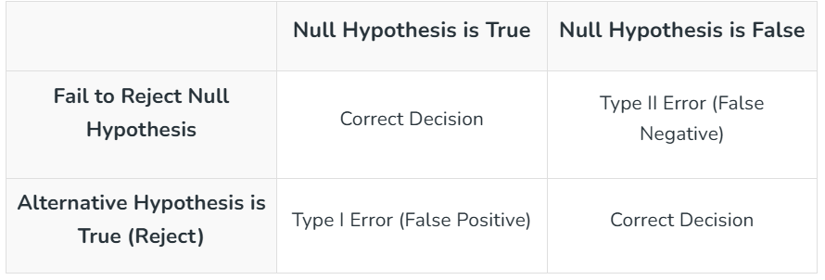
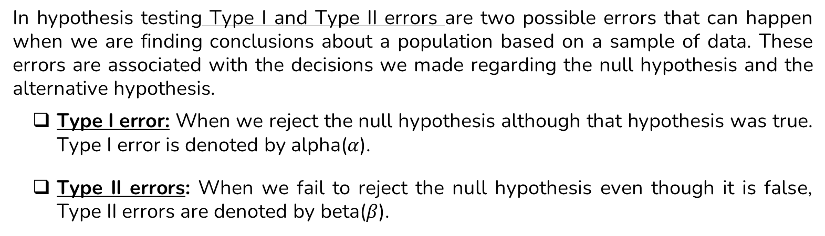
Type 1 and Type 2 errors in Hypothesis Testing
In hypothesis testing Type I and Type II errors are two possible errors that can happen when we are finding conclusions about a population based on a sample of data. These errors are associated with the decisions we made regarding the null hypothesis and the alternative hypothesis.
Type I error: When we reject the null hypothesis although that hypothesis was true. Type I error is denoted by alpha($α$).
Type II errors: When we fail to reject the null hypothesis even though it is false, Type II errors are denoted by beta($β$).

Slide 8
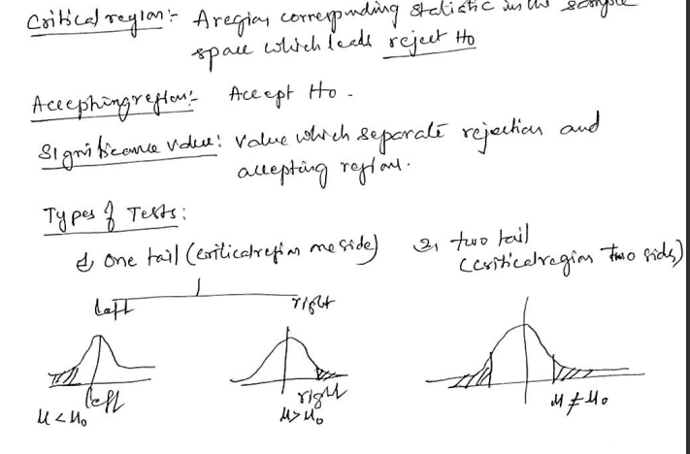

Slide 9
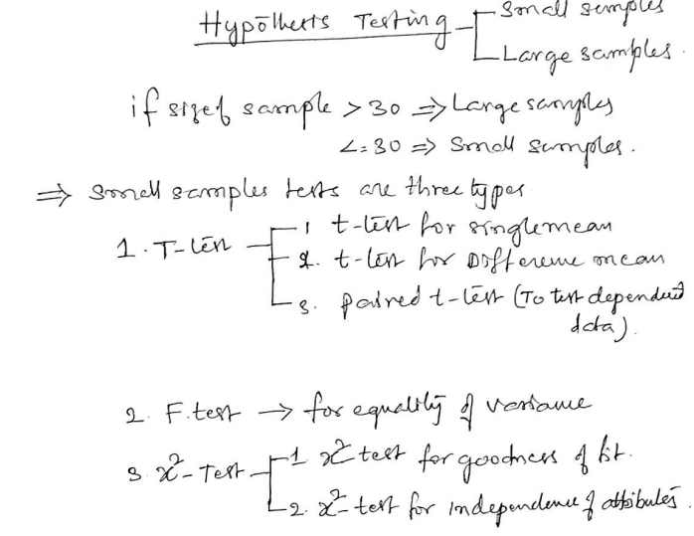
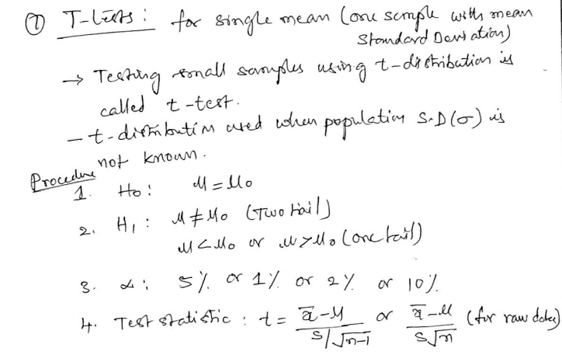

Slide 10
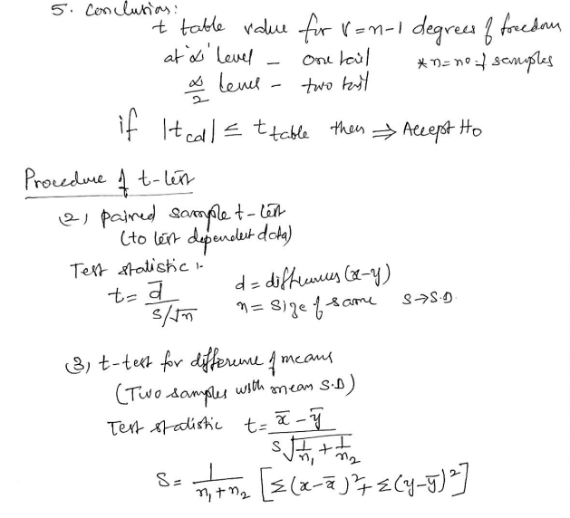


Slide 11
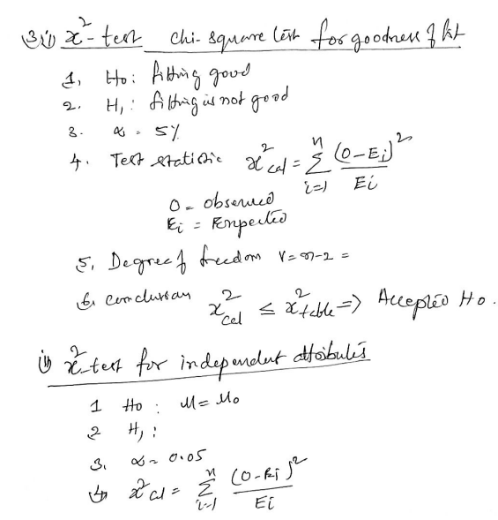

Slide 12
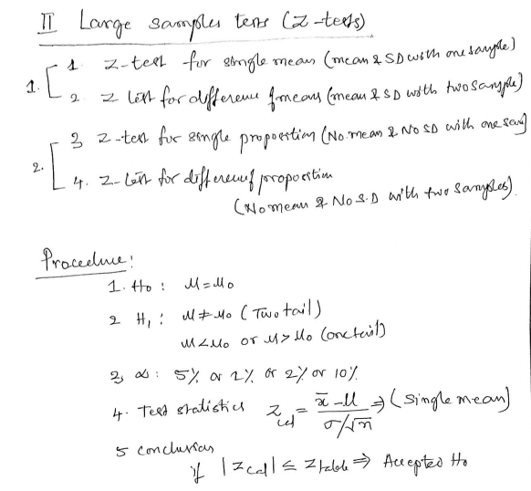
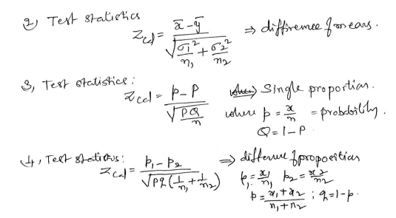

Slide 13
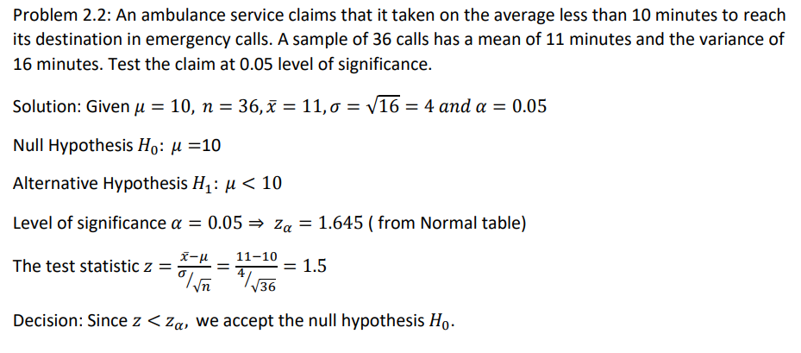

Slide 14
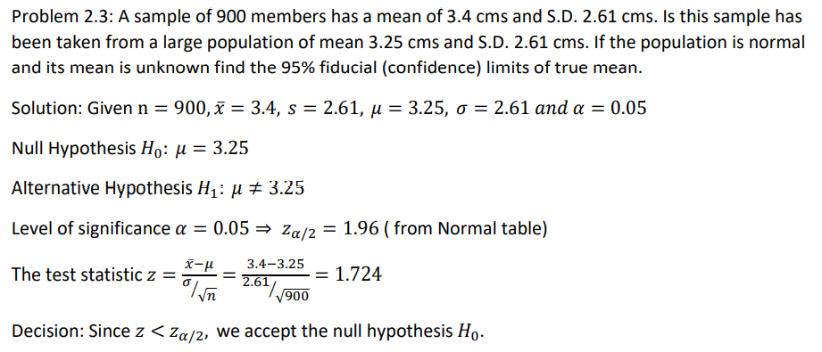

Slide 15
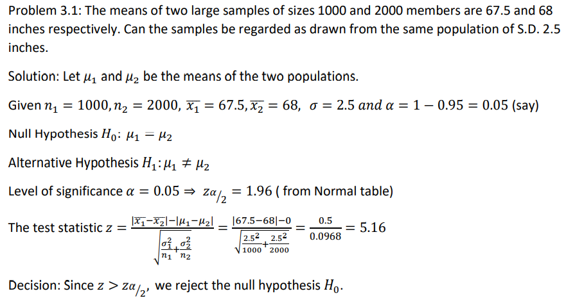

Slide 16
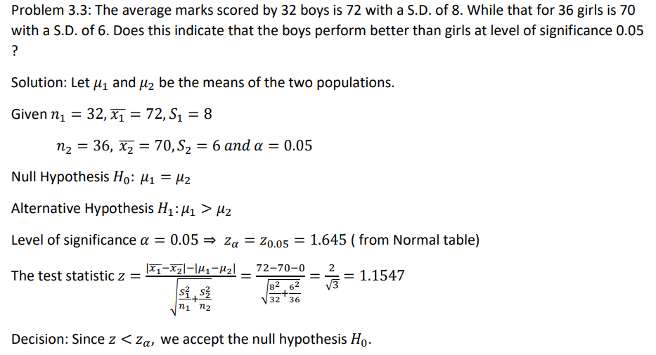

Slide 17
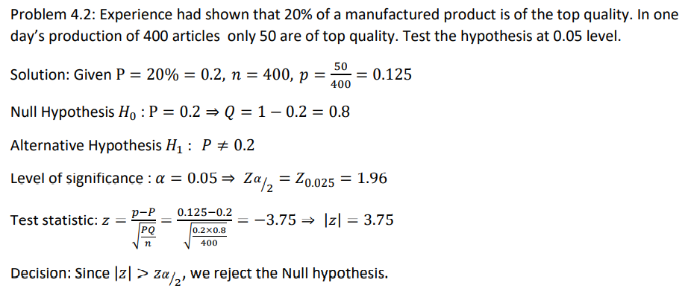

Slide 18
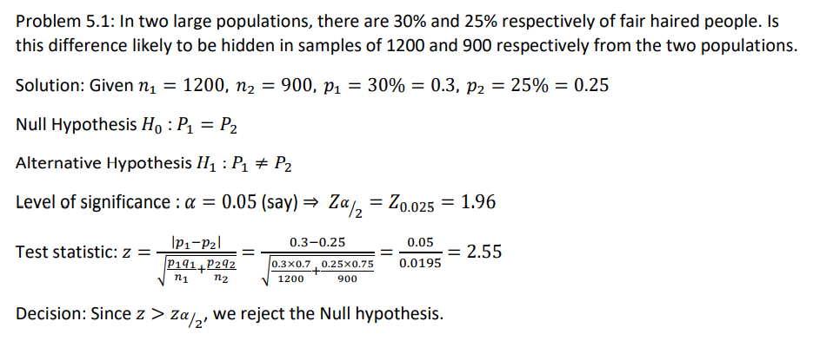

Slide 19
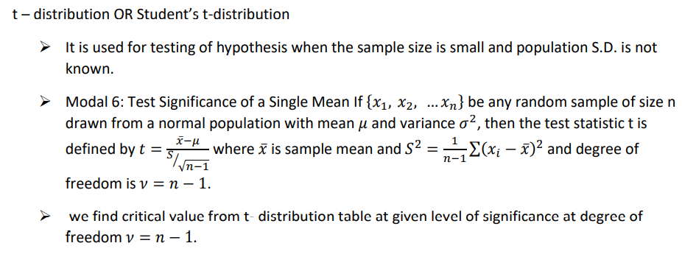

Slide 20
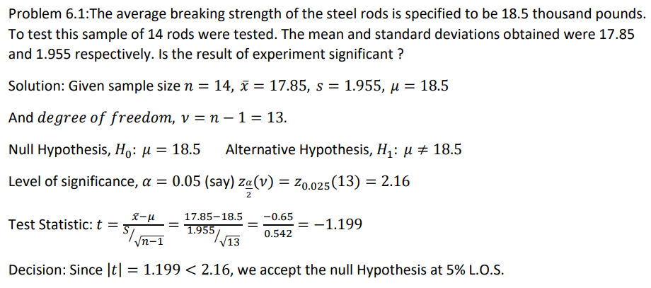

Slide 21
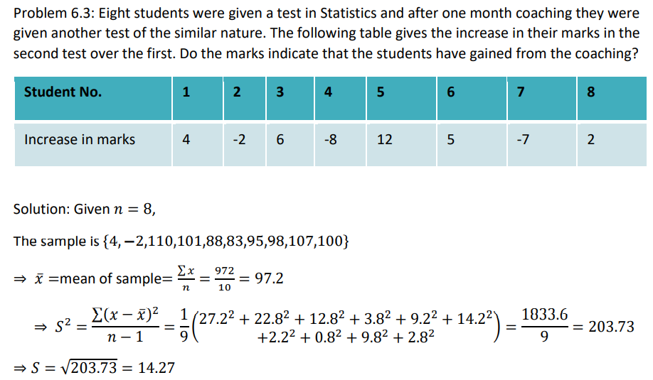

Slide 22
